Slide 1
HR DATABASE MANAGEMENT SYSTEM

Slide 2
In today's dynamic business environment, efficient management of human resources is crucial for organizational success. An HR Database Management System (HRDBMS) plays a pivotal role in achieving this efficiency.
An HRDBMS is essentially a digital system designed to store, organize, and manage all employee-related information. It acts as a centralized hub for HR data, replacing traditional paper-based systems.
An HRDBMS transforms HR operations by digitizing and streamlining processes, leading to increased efficiency, accuracy, and strategic decision-making.
By implementing an effective HRDBMS, organizations can optimize their HR functions and create a more productive and engaged workforce.
Introduction

Slide 3
Queries are powerful for filtering data based on conditions from another table or a summarized result. Aggregate functions (MAX, AVG, MIN) provide insights into data distribution and summaries.
GROUP BY allows you to perform calculations and analysis on groups of rows.
Comparing Values Across Groups . ALL operator compares a value to all values in a set, enabling comparisons across different groups.
This is useful for finding employees whose salaries exceed the minimum or maximum salaries in all departments.
Comparing Values Across Groups . ALL operator compares a value to all values in a set, enabling comparisons across different groups.
This is useful for finding employees whose salaries exceed the minimum or maximum salaries in all departments.
Nested queries can be used to calculate the average of averages (e.g., average of average department salaries).
You can calculate the difference between individual values and an average to understand how each value deviates from the norm.
Key Findings

Slide 4
Retrieve and filter data based on various criteria.
Perform calculations and aggregations on groups of data.
Compare values across different groups.
Analyze salary distributions and identify outliers.
Understand relationships between employees and departments.
By applying these techniques, you can gain valuable insights into your employee and department data, enabling you to make informed decisions regarding compensation, staffing, and organizational structure.

Slide 5
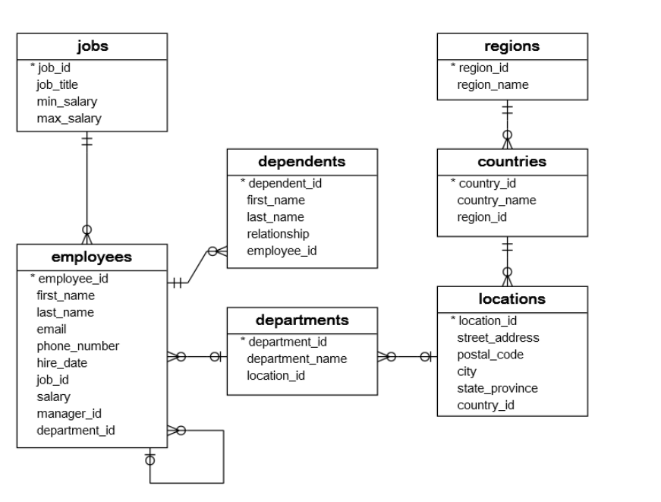
Actionable

Slide 6
Departmental Analysis:
Group the results by department name to analyze the distribution of employees and job titles within each department (1, 2, and 3).
Why: Identify staffing needs, skill gaps, or potential areas for restructuring within those departments.
Job Title Analysis:
Action: Group the results by job title to see the distribution of job roles across the selected departments.
Why: Determine if certain job titles are concentrated in specific departments, which could indicate specialization or potential redundancies.
Employee Contact List:
Action: Use the first_name and last_name columns to create a contact list for employees in departments 1, 2, and 3.
Why: Facilitate communication, team-building, or targeted announcements.

Slide 7
Salary Review (if you had salary data):
Action (if you included salary): Add salary information to the query and analyze salary ranges within each department or job title.
Why: Identify potential pay disparities or areas where salary adjustments might be necessary.
Performance Reviews (if you had performance data):
Action (if you had performance data): If you had performance data, you could join that to this query, and then review the employee performance within those departments.
Why: see the performance of each department.
Training Needs:
Action: Analyze the job titles and department names to identify potential training needs for employees.
Why: Ensure employees have the necessary skills to perform their roles effectively.

Slide 8
Resource Allocation:
Action: Use the employee distribution data to inform resource allocation decisions for departments 1, 2, and 3.
Why: Ensure each department has adequate resources (e.g., equipment, budget) to support its operations.
How to Implement Actions:
Data Visualization: Use tools like Excel, Tableau, or Power BI to create charts and graphs that visualize the data.
Reporting: Generate reports that summarize the findings and recommendations.
Communication: Share the insights with relevant stakeholders, such as department managers or HR.
Further Investigation: If any anomalies or areas of concern are identified, conduct further investigations to understand the root causes.

Slide 9
When addressing the task of creating and populating the HR management database, along with executing the provided SQL queries, a systematic approach is crucial. Here's a breakdown of methodologies :-
Requirements Analysis:
Clearly understand the entities involved (regions, countries, locations, jobs, departments, employees, dependents) and their relationships.
Identify the attributes for each entity and their data types.
Define primary keys and foreign keys to enforce data integrity.
.
Methodologies

Slide 10
Logical Design:
Create an Entity-Relationship Diagram (ERD) to visually represent the database structure. Tools like draw.io, Lucid chart, or MySQL Workbench can be used.
Normalize the database to reduce data redundancy and improve data consistency.
Physical Design:
Choose a database management system (DBMS) like SQL Server, MySQL, PostgreSQL, etc.
Write the SQL Data Definition Language (DDL) statements to create the database and tables, as provided in the script.
Ensure that appropriate data types, constraints (primary keys, foreign keys, NOT NULL), and indexes are defined.

Slide 11
Implementation:
Execute the DDL scripts in the chosen DBMS to create the database structure.
Verify the creation of tables and constraints.
Data Preparation:
Organize the data to be inserted into a format that aligns with the table structures.
Ensure data accuracy and consistency.
SQL INSERT Statements:
Use the provided INSERT INTO statements to populate the tables.
Execute these statements in the DBMS sequentially, respecting foreign key dependencies.

Slide 12
Bulk Import (if applicable):
For large datasets, consider using bulk import tools provided by the DBMS (e.g., BULK INSERT in SQL Server, LOAD DATA INFILE in MySQL).
This method is generally faster than individual INSERT statements.
Verification:
After insertion, use SELECT queries to verify that the data has been inserted correctly.
Check for any data integrity issues.
Query Execution
Understanding Query Requirements:
Carefully analyze each query requirement to understand the desired results.
Break down complex queries into smaller, manageable parts.

Slide 13
Query Writing:
Write the SQL queries based on the requirements, using appropriate clauses (SELECT, FROM, WHERE, ORDER BY, DISTINCT, TOP, LIKE, BETWEEN, IN, etc.).
Use subqueries and joins when necessary.
Query Execution and Optimization:
Execute the queries in the DBMS.
Analyze the query execution plan to identify potential performance bottlenecks.
Optimize queries by adding indexes, rewriting queries, or adjusting database settings.
Result Verification:
Verify that the query results match the expected outcomes.
Test queries with different data inputs to ensure robustness.

Slide 14
Incremental Development:
Develop and test the database structure and data insertion in stages.
This approach allows for early detection and correction of errors.
Version Control:
Use version control systems (e.g., Git) to manage database scripts and query files.
This helps track changes and facilitates collaboration.
Documentation:
Document the database design, data insertion process, and query execution steps.
This makes it easier to maintain and troubleshoot the database.
Testing:
Thoroughly test the database and queries to ensure data integrity and accuracy.
Use test data to simulate various scenarios.

Slide 15
Performance Tuning:
Monitor database performance and optimize queries as needed.
Regularly review and update database indexes.
Data Validation:
implement data validation checks when inserting or updating data to insure data integrity.
Code Readability:
Format SQL code for readability and maintainability. Use consistent naming conventions and indentation.

Slide 16
Break down the approaches to create the HR management database, its tables, populate them with data, and execute the provided SQL queries.
Sequential Execution:
Execute the CREATE DATABASE HR management; statement first to establish the database environment.
Then, execute each CREATE TABLE statement in the order they appear. This is vital because of foreign key dependencies. For example, regions must exist before countries, and countries before locations.
This step ensures that all tables and their constraints are created correctly.
Approaches

Slide 17
Verification:
After execution, use the SQL client's object explorer or system catalog queries to verify that all tables and their constraints (primary keys, foreign keys) have been created as intended.
Scripting:
Save all the CREATE TABLE statements in a single SQL script file (.sql). This allows for easy execution and version control.
Using a SQL client (like SSMS for SQL Server), connect to your SQL server instance and execute the script.

Slide 18
2. Data Insertion (DML)
Ordered Insertion:
Insert data into the tables in an order that respects foreign key constraints. Start with parent tables (like regions) and then proceed to child tables (like countries, locations, employees).
This avoids foreign key constraint violations during insertion.
Scripting:
Similar to table creation, save all the INSERT INTO statements in a separate SQL script file.
Execute this script after the table creation script.
Transactional Integrity (Optional):
For larger datasets or critical applications, consider using transactions. This ensures that either all insertions succeed, or none do.

Slide 19
Query Execution (SELECT, ORDER BY, DISTINCT, TOP, WHERE, ALTER, etc.)
Step-by-Step Execution:
Execute each query individually to understand its result.
This allows for easy debugging and verification.
Understanding Query Logic:
Before executing a query, analyze its logic.
Identify the tables involved, the filtering conditions (WHERE), sorting criteria (ORDER BY), and desired columns (SELECT).
Using SQL Client:
Use the SQL client's query editor to execute the queries.
Review the query results in the client's result pane.

Slide 20
Query Optimization (Where Applicable):
For queries involving large datasets or complex operations, analyze the query execution plan.
Identify potential bottlenecks and optimize the query by adding indexes, rewriting the query, or adjusting database settings.
Testing Edge Cases:
Test queries with various inputs to verify that they handle edge cases correctly. For example, test queries that use LIKE with different pattern matching scenarios.
Alter Table operations:
When using Alter table commands, it is very important to backup your data before executing these commands.
When using Alter table commands, if you are changing the data type of a column, make sure that the data within that column is compatible with the new data type.

Slide 21
Foreign Key operations:
When creating foreign keys, make sure that the parent table's primary key already contains all of the values that you will be inserting into the child table's foreign key column.
Subqueries:
When using subqueries, make sure that the subqueries return the correct data types, and that they return the correct number of columns.
Like operations:
When using the like operator, make sure that you understand the difference between the '%' wildcard and the '_' wildcard.
Between operations:
When using the between operator, make sure that you understand that the between operator is inclusive of both the start and end values.

Slide 22
In operations:
When using the in operator, make sure that you understand that the in operator is used to specify a list of values.
All operations:
When using the all operator, make sure that you understand that the all operator is used to compare a value to every value in a list.

Slide 23
Insights
Let's break down the insights from the provided SQL script, covering database design, data insertion, and query execution:
Normalization:
The database is designed with a good degree of normalization, reducing data redundancy. Tables like regions, countries, locations, jobs, and departments are separated, which improves data integrity.
Foreign keys are used effectively to establish relationships between tables.
Data Types:
Appropriate data types are used for each column. INT for IDs, VARCHAR for strings, DECIMAL for salaries, and DATE for hire dates.
CHAR(2) is used for country id, which is a good choice for fixed length codes.

Slide 24
Constraints:
Primary keys and foreign keys are defined to enforce data integrity.
NOT NULL constraints are used where necessary (e.g., city, last_name, email, hire_date, job_id , salary).
ON DELETE CASCADE ON UPDATE CASCADE is used, which is good for keeping data clean, but can cause unintended data loss if not used carefully.
Default Values:
DEFAULT NULL is used for some VARCHAR columns, which is acceptable but might be worth reconsidering depending on the application's requirements.

Slide 25
Data Insertion Insights
Data Consistency:
The data insertion scripts seem to maintain consistency with the database schema and constraints.
The order of insertion respects foreign key dependencies.
Potential Issues:
INSERT INTO VALUES (8,'Matthew','Chen','Child',110); this insert statement is missing the dependents table name. This will cause an error.
The email addresses all end in '@sqltutorial.org' which is fine for test data,but should be noted.
Some phone numbers are null, which may or may not be acceptable for a production environment.
Data Distribution:
The data provides a reasonable distribution across regions, countries, departments, and jobs.

Slide 26
This SQL script provides a comprehensive foundation for an HR management database.
Robust Database Design:
The schema exhibits good normalization, utilizing primary and foreign keys to establish relationships and ensure data integrity.
Data Population and Consistency:
The data insertion scripts maintain consistency with the schema, providing a realistic dataset for testing and analysis.
Conclusions

Slide 27
Comprehensive Query Examples:
The script covers a diverse set of SQL operations, from basic SELECT statements to complex subqueries and window functions, providing valuable examples for database interaction.
Learning and Development:
This script serves as an excellent resource for learning and practicing SQL, particularly for those working with relational databases.
Areas of Improvement:
As noted earlier, the script could be further enhanced by implementing error handling, data validation, indexing, and more comprehensive testing. Also, the inconsistencies with the courses table, and the malformed insert statement into the dependents table should be corrected.

